Slide 1

Customer Shopping Behavior Analysis
Uncovering insights from transactional data to guide strategic business decisions.

Slide 2


Project Overview
1
2
3
Data Analysis
Key Insights
Strategic Guidance
Analyzed 3,900 purchases across product categories.
Spending patterns, customer segments, product preferences.
Inform business decisions and optimize operations.

Slide 3

Dataset Summary
Rows: 3,900
Key Features
Columns: 18
Customer demographics (Age, Gender, Location, Subscription)
Missing Data: 37 values in Review Rating.
Purchase details (Item, Category, Amount, Season, Size, Color)
Shopping behavior (Discount, Promo, Previous Purchases, Frequency, Review, Shipping)

Slide 4
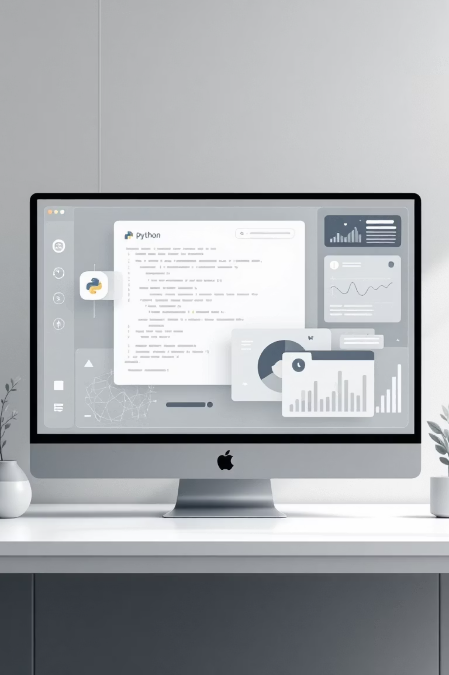
Exploratory Data Analysis (Python)
01
Data Loading & Exploration
Imported with pandas, checked structure and summary statistics.
02
Data Cleaning
Handled missing values in 'Review Rating' using median imputation.
03
Feature Engineering
Created 'age_group' and 'purchase_frequency_days'.
04
Database Integration
Loaded cleaned data into PostgreSQL for SQL analysis.

Slide 5
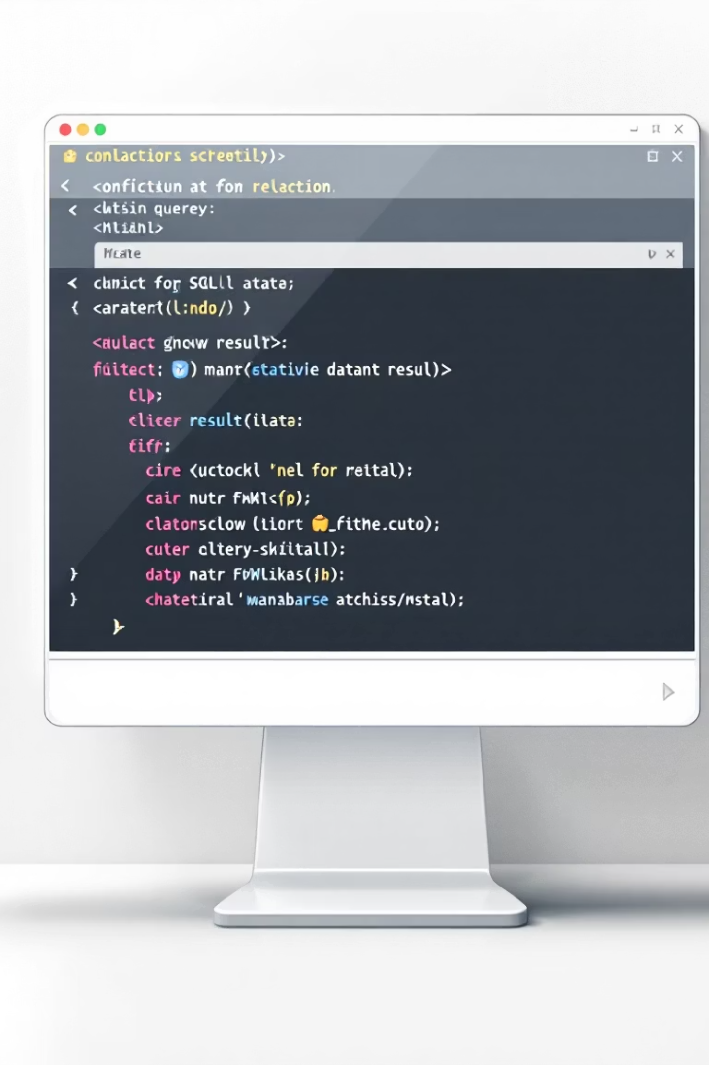
Data Analysis (SQL)
Revenue by Gender
1
Female: $75,191 | Male: $157,890
Top 5 Products by Rating
2
Gloves (3.86), Sandals (3.84), Boots (3.82), Hat (3.80), Skirt (3.78)
Shipping Type Comparison
3
Standard: $58.46 | Express: $60.48

Slide 6
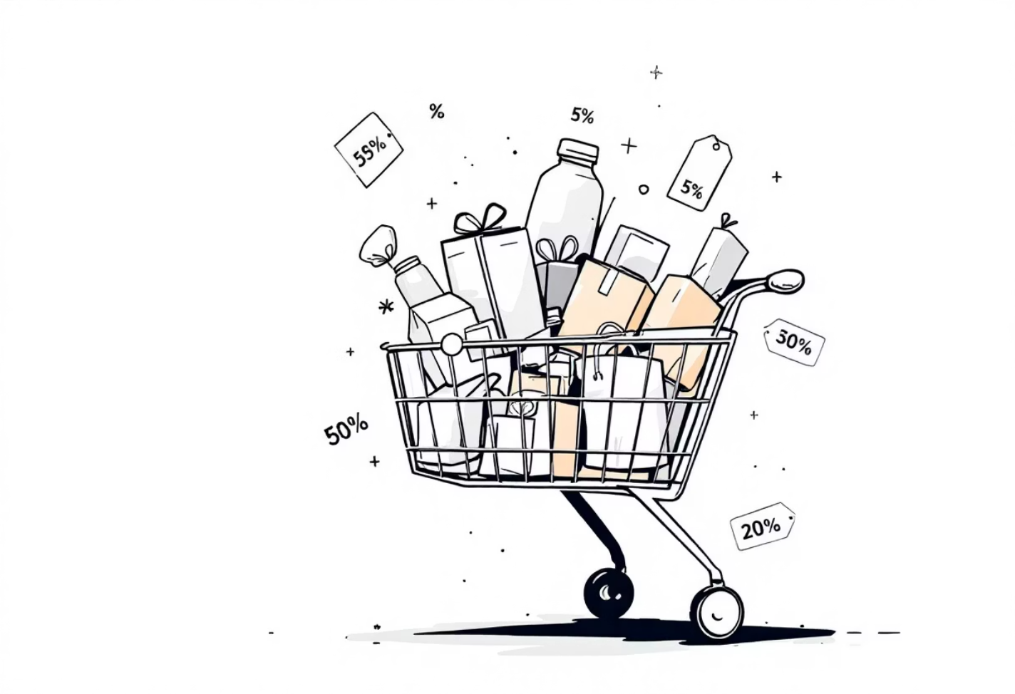
SQL Insights: Subscriptions & Discounts
Subscribers vs. Non-Subscribers
Discount-Dependent Products
Yes
1,053
$59.49
$62,645
Hat: 50.00%
Sneakers: 49.66%
No
2,847
$59.87
$170,436
Coat: 49.07%
Sweater: 48.17%
Pants: 47.37%

Slide 7
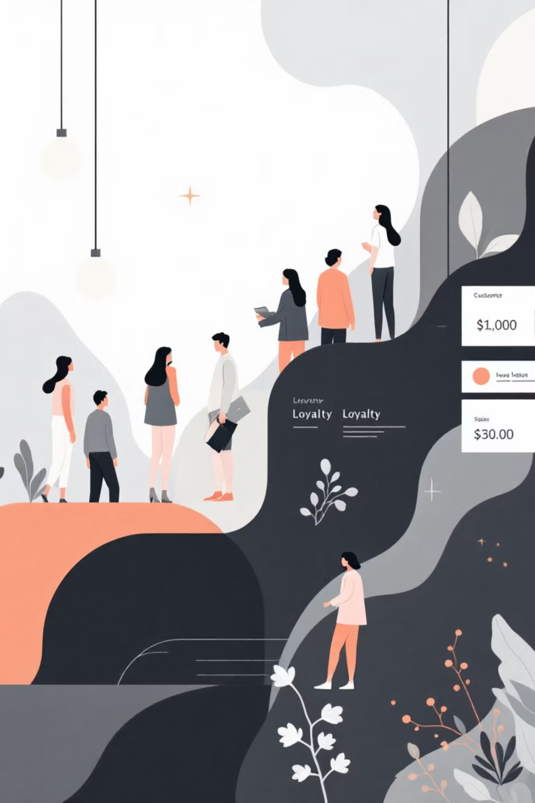




Customer Segmentation & Loyalty
Loyal
Returning
3,116 Customers
701 Customers
New
83 Customers
Repeat buyers with >5 purchases: 958 subscribers vs. 2,518 non-subscribers.

Slide 8
Top Products by Category
1
Accessories
Jewelry
1
Clothing
Blouse
1
Footwear
Sandals
1
Outerwear
Jacket

Slide 9
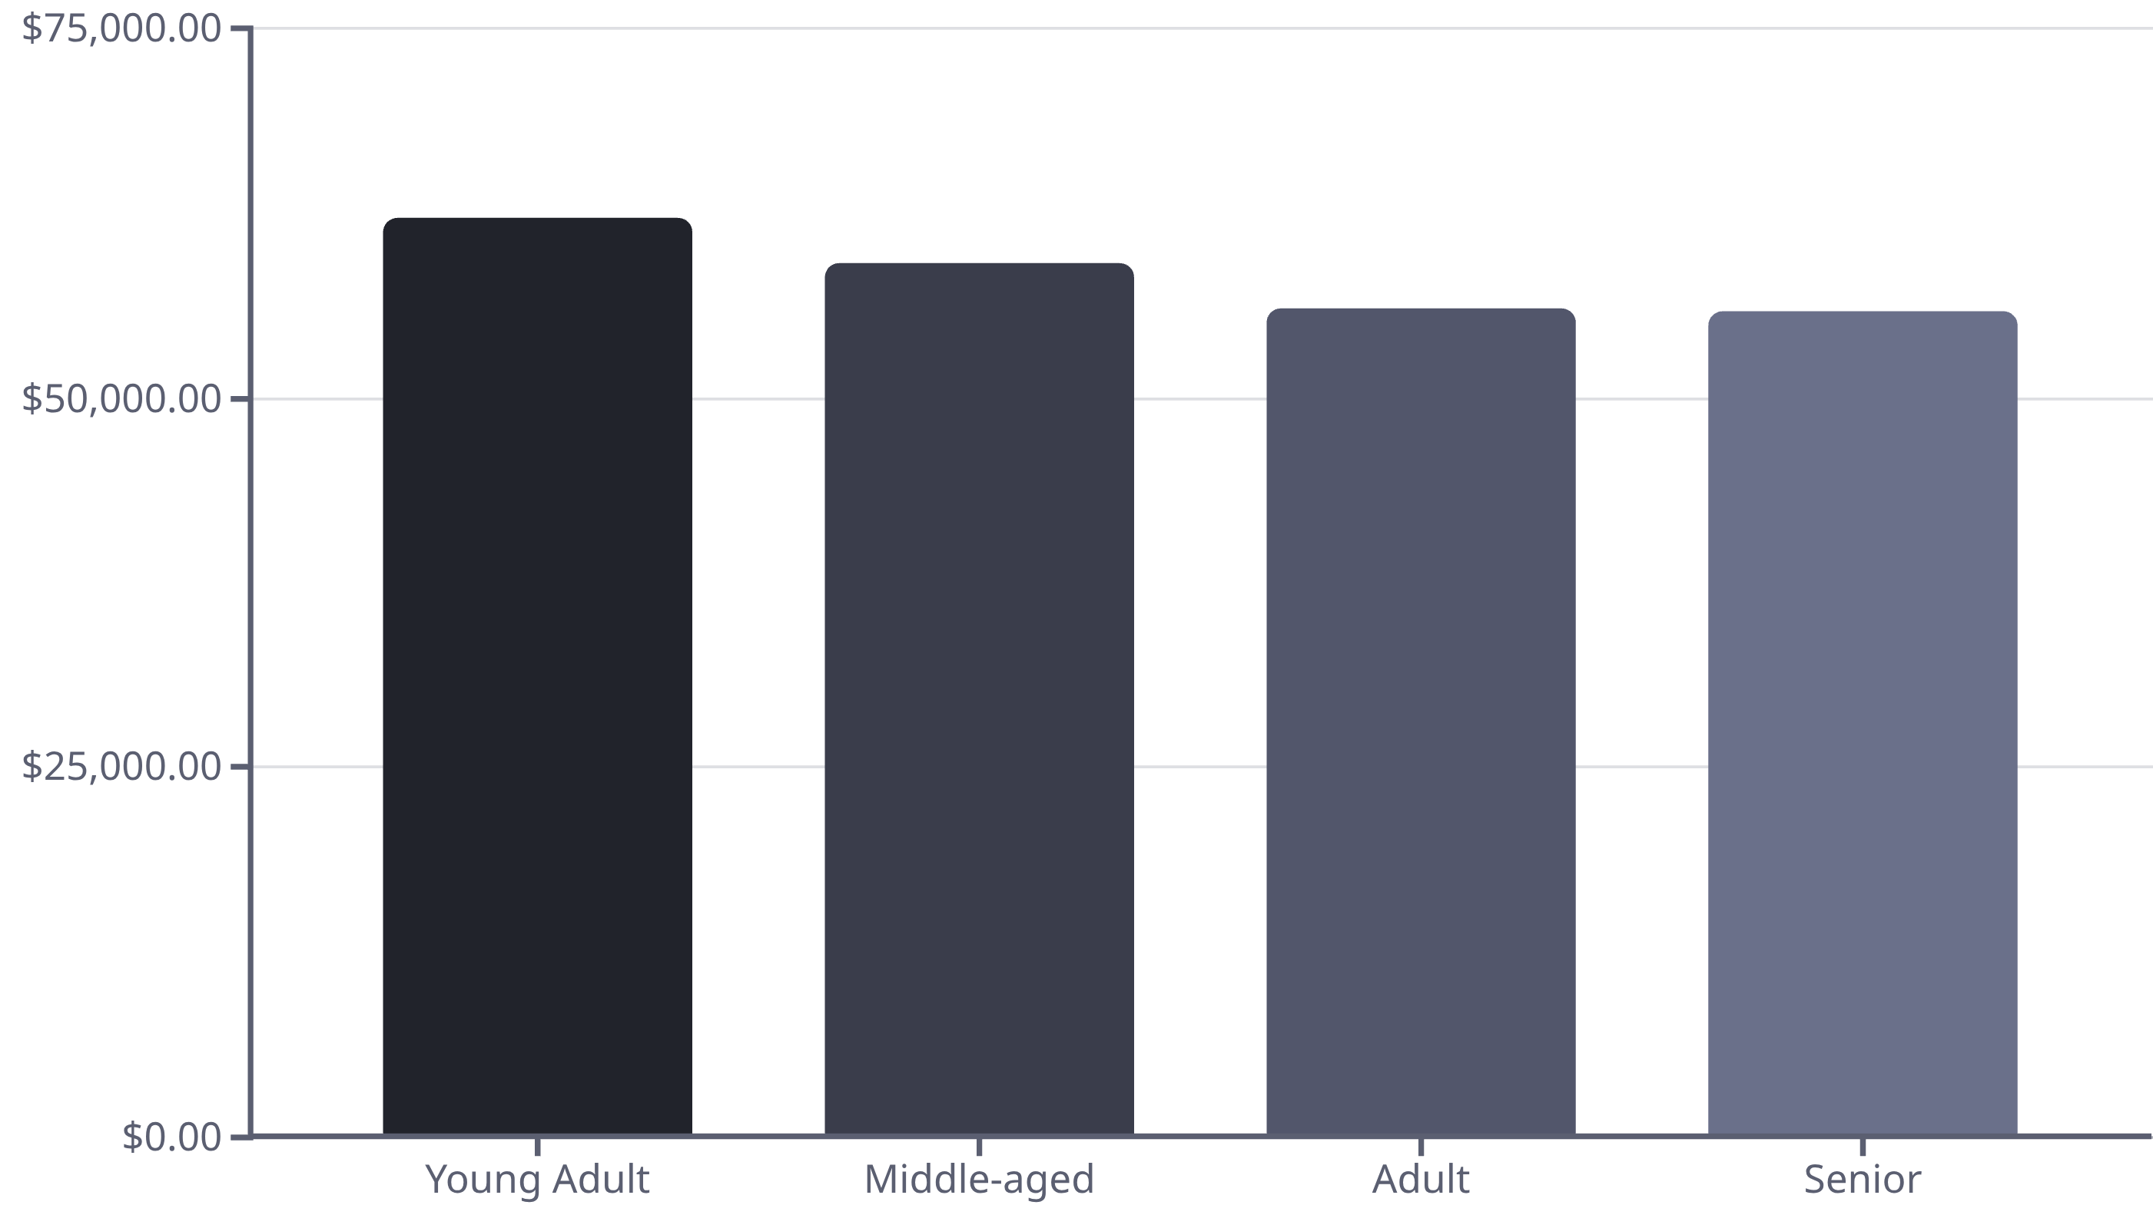
Revenue by Age Group
Young Adults contribute the highest revenue, followed closely by Middle-aged customers.

Slide 10
Business Recommendations
Boost Subscriptions
Promote exclusive benefits for subscribers.
Customer Loyalty Programs
Reward repeat buyers to foster loyalty.
Review Discount Policy
Balance sales boosts with margin control.
Product Positioning
Highlight top-rated and best-selling products.
Targeted Marketing
Focus on high-revenue age groups and express-shipping users.

